Slide 1
Community Connections:
Building local partnerships for aspiring entrepreneur artisans
April 1, 2025

Slide 2

Land Acknowledgement

Slide 3
Today’s Objective
Athabasca Chipewyan First Nation (ACFN) online series for entrepreneurs, artisans and craftspersons
Transforming skills into business opportunities
Participants include:
Community members interest in entrepreneurship
Students and new grads interest in entrepreneurship

Slide 4

ACFN is collaborating with Catalyste+ on this virtual workshop series

Slide 5
Outline
Introduction
Entrepreneurship
What are your best sellers?
Pricing
Selling venues and platforms
Storytelling through art
Questions and Wrap-up

Slide 6

Introduction
Turn on your camera please for your introduction
  Give us your name
  What is your artistic activity?
  What do you want to get out of this workshop? /What questions do you have that you want answered?

Slide 7
Julia Ewing
Interest in clothing and textiles from childhood
Bachelor of Human Ecology with major in clothing and textiles
MBA
Craft shop in Iqaluit
Business instruction
Ec dev in Paulatuk
Mining
Volunteering overseas

Slide 8
Interactive Session
active participation session
share ideas and learn from one another

Slide 9
Entrepreneurship
  Why do individuals want to start a business??
    Be my own boss
    I want to generate some income
    Creating art is my passion. I enjoy making art/ crafts.
    I need an outlet for all my production
    I want to support my art habit
    Cultural exploration and preservation

Slide 10

Discussion: Why do I want to start a business?
What are your motivations for starting a business?
What are your strengths for becoming an entrepreneur?
What’s your vision?

Slide 11
Entrepreneurship
  What are some limitations of a micro enterprise?
    Some of the limitations of a micro enterprise (quality arts and crafts are time consuming to produce); don’t quit your day job – if you have one
    Can’t charge enough to cover materials, overhead and (especially) labour
    Would a side hustle work better ?
    Have you experienced limitations?

Slide 12
What are your best sellers?
Get a sense of your market
  Start with small steps
  Input from family and friends
  Do a table at community event, pow wow, etc.

Slide 13

Discussion: What are your best sellers?
  What are some of your best sellers?
    Why?

Slide 14

Pricing
  How do you come up with a price for your product?
    Notebook or spreadsheet to track inputs of material, time, overhead and profit
    Observe your competition

Slide 15
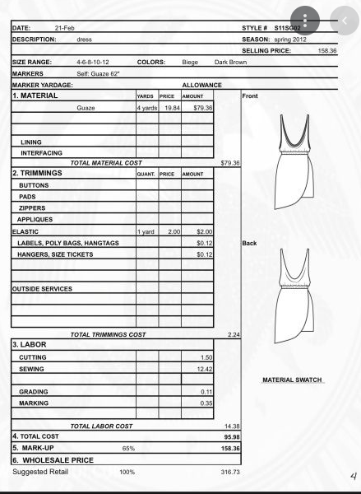
Pricing

Slide 16

Discussion: Pricing
  Pricing your product right
  Using the Cost Sheet as a guide do an estimate of your cost of product.

Slide 17
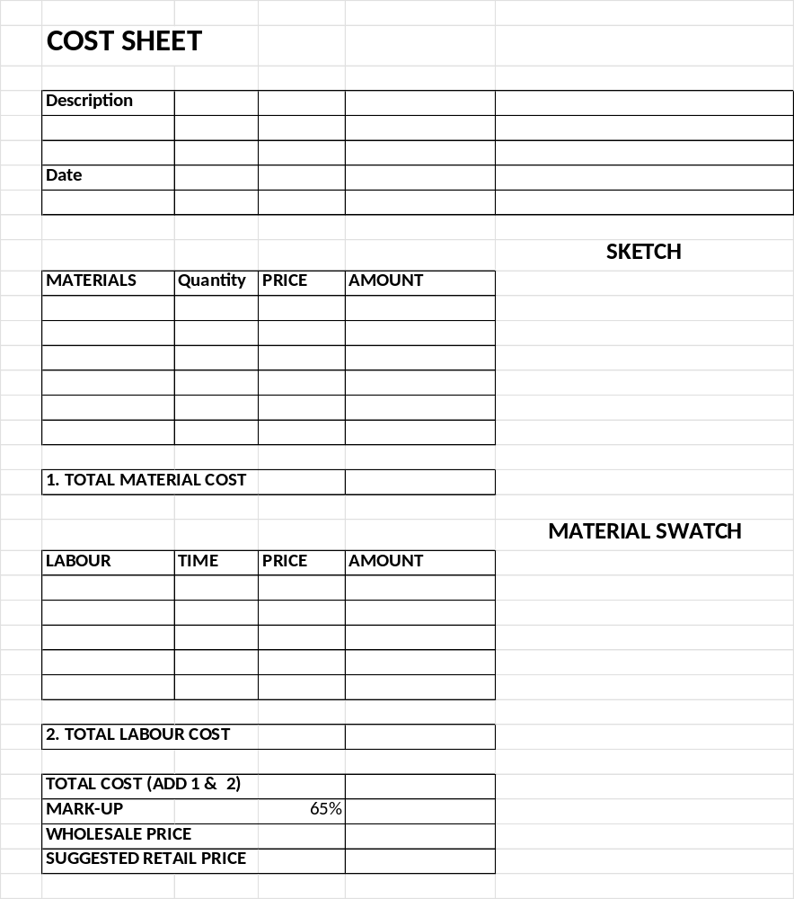
Pricing

Slide 18

Selling Venues and Platforms
  How are you going to reach your potential customers?
  In-person direct to customer: craft fairs, pow wows, local markets
  Thought intermediaries: galleries, stores, brokers
    Wholesale
    Retail – Consignment or set price
  On-line marketplaces: Etsy, Facebook Market Place
  Selling direct to customers maximizes your return

Slide 19

Discussion: Selling Venues and Platforms
  What avenues have you used for selling your work?

Slide 20

Storytelling Through Art
  Uniqueness of indigenous art
  Incorporating Cultural Values: integrate traditional practices and stories into your work. In the spirit of reconciliation many customers want to know the story or significance about products.

Slide 21
Discussion: Storytelling Through Art
  Write or record the story behind your craft and discuss how you can use this in product descriptions, social media, or branding.

Slide 22
Summary
Introduction
Entrepreneurship
What are your best sellers?
Pricing
Selling venues and platforms
Storytelling through art
Questions and Wrap-up

Slide 23

Questions?

Slide 24
Contact Information
Julia Ewing BHEc MBA
Catalyste+ Volunteer Advisor
julia.ewing@sasktel.net

